Slide 1
Kahneman & Deaton (2010) “High Income Improves Evaluation of Life but Not Emotional Well-being”
By: Luke Buddie, Samantha Vargas, Angel Sandoval, Mingze Weng, Arielle Makedonsky, Madeleine Rael

Slide 2
Main Question & Objective of the Study
Does higher income improve people’s emotional well-being (their daily feelings) and their life evaluation (how they think about their life) in the same way, or do these two aspects of well-being relate to income differently?
To examine whether money “buys happiness” and to determine if income has a continuous effect on life evaluation while having a limited or capped effect on emotional well-being.

Slide 3
Hypothesis 1
Higher income will be associated with higher life evaluation. (how people rate their overall life).
Hypothesis 2
Higher income will improve emotional well-being, but only up to a certain level,
after which additional income will no longer increase daily happiness.

Slide 4
Methodology: Surveying
Very large dataset: more than 450,000 respondents
31% of eligible candidates agreed to be interviewed; 90% of the 31% completed the survey
Up to 5 callbacks if no answer the first time
Dual frame random digit dialing with phone numbers from all 50 states
Cell phones and landlines were included; more response from landlines than cell phones
Interviews in English and Spanish
Gallup-Healthways Wellbeing Index was used to conduct a daily survey of approximately 1000 U.S adults each day in all 50 states
Asked about emotions, life satisfaction, health/lifestyle, work environment, fiances, social relationships in addition to other background variables
Life evaluation questions were asked using Cantril’s Self Anchoring Scale
“Imagine a ladder, 0 is the worst life could be for you and 10 is the best, what step are you on”
Yes/no questions were asked to assess emotional wellbeing
Enjoyment, happiness, smiling/laughter, stress, worry, sadness, anger
The answers to these questions created positive affect, blue affect and stress affect
Emotions were controlled

Slide 5
Methodology: Income
These income categories: 0, <$60, and $60–499/month were deleted due to the unrealistic nature
No reported income was also deleted
Log income was regressed based on indicators for congressional district, education, sex, age, age squared, race categories, marital status categories, and height
Given these categories, regression explain 37% of variance, if participants were 2.5x the Root Mean Square Error (RMSE) they were removed because they were either an outlier or an implausible income report
28% of the original dataset was removed from these cleaning methods
Income groups were as follows: <$60k, $60–90k, $90–120k, $120k

Slide 6
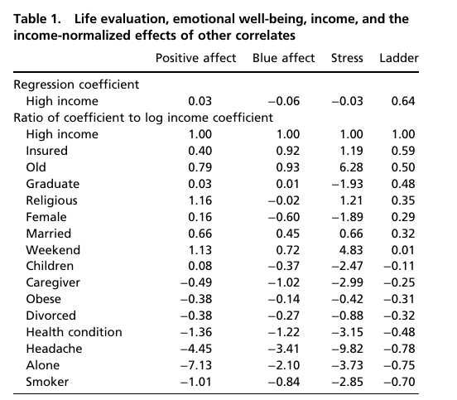
Results
Subjective well-being can be clearly divided into two categories: emotional well-being and life evaluation .
The impact of income on emotional well-being has a satiation threshold: Emotional well-being increases with income but peaks at an annual income of approximately $75,000. Beyond this threshold, no significant improvements are seen. Notably, the satiation point for stress is lower, at around $60,000 annually.
Different factors have varying weight in influencing the two types of well-being: Factors such as health conditions, loneliness, smoking, and caregiving have stronger predictive power for emotional well-being; in contrast, income and education level are more closely associated with life evaluation .

Slide 7
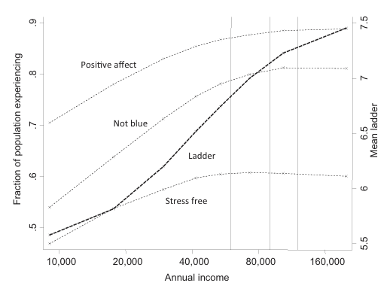
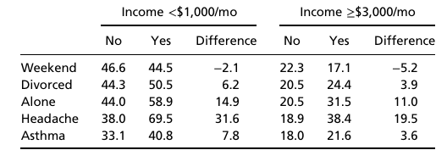
Results
4. Low income exacerbates emotional distress from negative events: For adverse experiences like divorce, illness, and loneliness, low-income groups experience significantly stronger negative emotions than high-income groups . Poverty amplifies the emotional impact of life hardships.
5. Demographic characteristics also influence well-being: Older adults have higher emotional well-being (especially reduced stress and anger); women report slightly higher positive affect and life evaluation but also more negative emotions and stress; religious belief enhances positive affect and reduces stress but has no significant effect on alleviating sadness or worry.

Slide 8
Key Takeaways
N = 450,000 US residents
$75,000 (in 2010 dollars) is the threshold for a marginal increase in happiness (well-being).
Above this level, more money does not make people experience more daily happiness or less daily misery.
Emotional well-being refers to the emotional quality of an individual’s everyday experience (intensity and frequency of emotions, hedonic well-being or experienced happiness).
Life evaluation refers to the thoughts that people have about their life when they think about it.
This evaluation is non-satiable: continues to rise with wealth with no threshold or ceiling
High Income buys life satisfaction, not happiness; Low income is associated with low life satisfaction and low emotional well-being.
Other life circumstances often matter more for daily emotions than money does above the threshold
Being lonely, having a headache, getting bullied, or being physically ill have larger negative effects on daily mood than the positive effect of moving from low to high income.

Slide 9
Key Takeaways
Emotional well-being and life evaluation are distinct; improving one doesn’t necessarily improve the other
Income relates more strongly to life satisfaction than to happiness
After basic financial stability is reached, factors of non-monetary value such as social connection, stress, health, etc. play a large part in shaping everyday emotional well-being
Income plays a role in reducing emotional suffering (when lacking financial stability)
Emotional well-being plateaus with high income, while life evaluation continues to increase

Slide 10
Discussion Questions:
The authors found that high income does not improve daily happiness. What does this imply about how people should think about career choices, life goals, or the pursuit of money?
The study shows that low income increases the emotional pain of divorce, illness, and loneliness. Why might poverty make negative experiences feel worse?
Why do you think people often believe that more money will make them much happier, even though this study shows that daily emotional happiness barely changes after a certain income level?
Notes:
Madeleine Rael
It suggests that chasing extremely high income may not make people emotionally happier once they reach a comfortable level. But beyond that threshold, people might get more emotional benefit from investing in friendships, reducing stress, or finding meaningful work.
if someone has low income, they often have less social support, less time, worse healthcare access, and more chronic stress. So when something bad happens, like divorce or illness, they don’t just deal with the event- they deal with it on top of financial insecurity.
The study shows a disconnect between what people think will make them happy and what actually affects their emotions day-to-day.

